Slide 1
OPERATING SYSTEMS (CS F372) Processes
Barsha Mitra
CSIS Dept., BITS Pilani, Hyderabad Campus

Slide 2
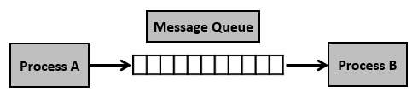
Message Queue
asynchronous communication
messages placed onto the queue are stored until the recipient retrieves them
Step 1 − Create a message queue or connect to an already existing message queue (msgget())
Step 2 − Write into message queue (msgsnd())
Step 3 − Read from the message queue (msgrcv())
Step 4 − Perform control operations on the message queue (msgctl())
Functions are defined in the header file <sys/msg.h>

Slide 3
msgget()
Creates a message queue or connects to an already existing message queue, as per the 1st arg.
int msgget(key_t key, int msgflg);
2 parameters:
key – Unique value which the message queue is associated with. If not associated with any existing queue, a new one is created (IPC_CREAT must be specified in msgflag for this.)
msgflg – Sets flags to control the behavior of the message queue. Examples include IPC_CREAT, IPC_EXCL,etc. Can also be zero.
On success, a message queue identifier is returned. (Non-negative integer). On failure, -1 is returned.
new queue will be created even if key is IPC_PRIVATE, but the queue will not be accessible to other processes

Slide 4
msgsnd()
send messages to a message queue, sender must have write permission on the message queue
int msgsnd(int msqid, const void* msgp, size_t msgsz, int msgflg);
4 parameters:
msqid – identifier for the message queue.
msgp– points to a user-defined structure containing the message.
msgsz– specifies the size in bytes of the message.
msgflg– specifies the action to be taken
Returns 0 if successful
Returns -1 if failed. No message is sent in this case.

Slide 5
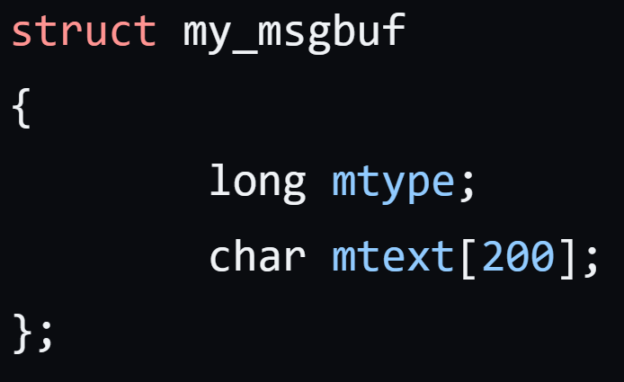
msgsnd()
Sample message buffer:
mtype is a mandatory field. More fields may be added as is necessary.

Slide 6
msgrcv()
Used to receive/remove a message from a specified message queue and of a specified mtype
ssize_t msgrcv(int msqid, void *msgp, size_t msgsz, long msgtyp,
int msgflg);
msqid – Identifier of the message queue
msgp – Points to a user-defined buffer where the read message is placed
msgsz – Max. size in bytes for the member mtext of the structure pointed to by the msgp argument
msgtyp – Used to specify the mtype of message to be read. If msgtyp is 0, the first message on the queue is read. If the value is < 0, the first message with mtype <= |msgtyp| read. Else, specified mtype read.
msgflg – Specifies the action to be taken

Slide 7
msgrcv()
On success, returns the size of the message received (no. of bytes copied into mtext).
If unsuccessful, -1 is returned.

Slide 8
msgctl()
Performs certain control operations on the message queue
int msgctl(int msqid, int cmd, struct msqid_ds* buf);
3 parameters:
msqid– identifier for the message queue
cmd – specifies control operations to be performed on the queue, such as IPC_RMID to delete the queue
buf – pointer to a user-defined structure
If successful, the specified control operation is performed on the message queue and 0 is returned, else -1 is returned.

Slide 9


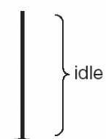

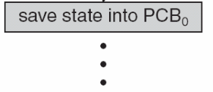
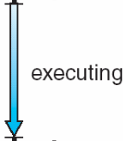

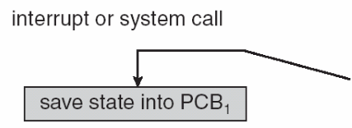

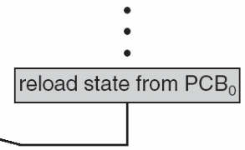
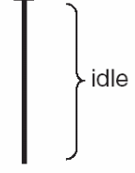

Context Switch
System must save state of the old process and load the state for the new process via context switch
Context of a process represented in PCB (CPU registers contents, process state, memory management info.)
Context-switch time is overhead
Time dependent on hardware support

Slide 10
Process Scheduling
Process scheduler selects among available processes for next execution on CPU
Maintains scheduling queues of processes
Job queue – set of all processes in the system
Ready queue – set of all processes residing in main memory, ready and waiting to execute, can be stored as a linked list
Device queues – set of processes waiting for an I/O device
Processes migrate among the various queues

Slide 11
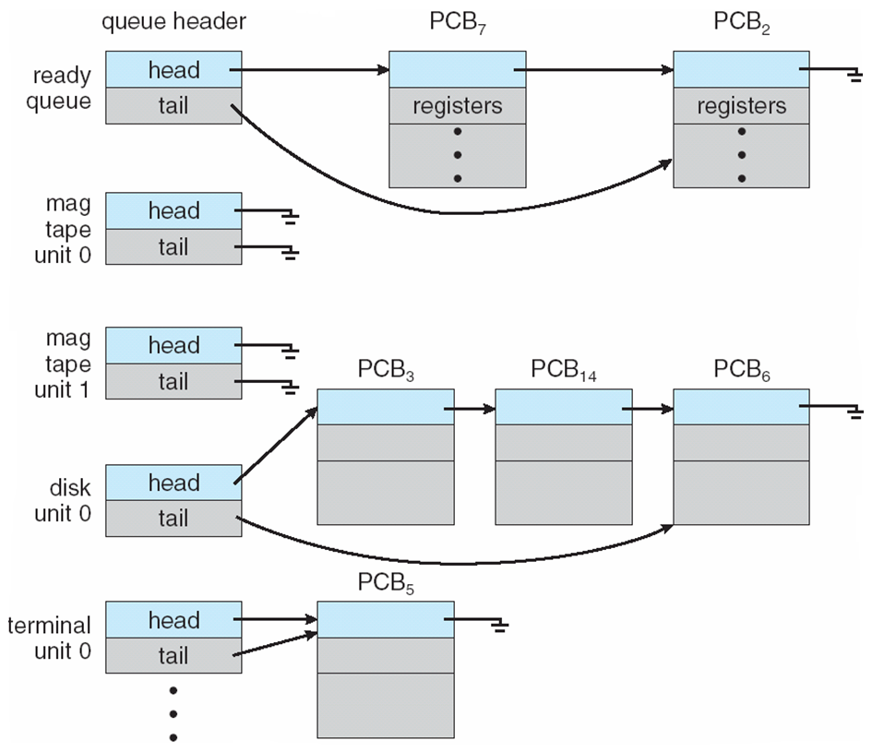
Various Queues

Slide 12
Schedulers
Short-term scheduler (CPU scheduler) – selects which process should be executed next and then dispatcher allocates the CPU to that process
invoked frequently (milliseconds) ⇒ (must be fast)
Long-term scheduler (job scheduler) – selects which processes from job queue should be brought into the ready queue
invoked infrequently (seconds, minutes) ⇒ (may be slow)
controls degree of multiprogramming (no. of processes in main memory)

Slide 13
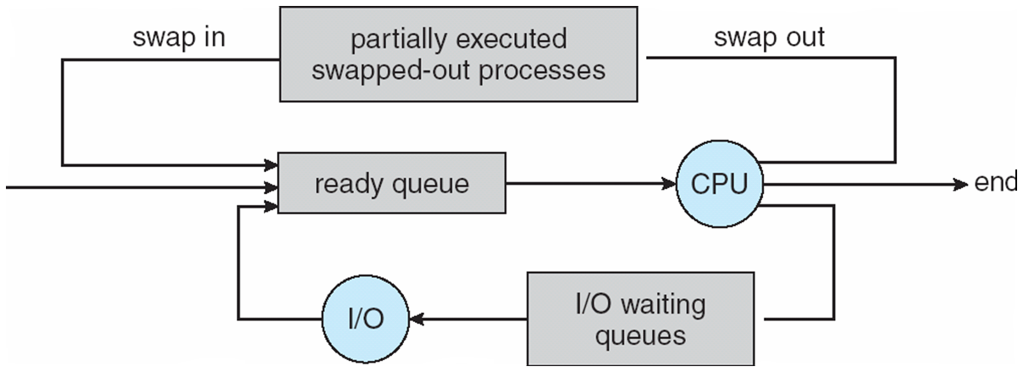
Schedulers
Medium-term scheduler can be added in time sharing systems if degree of multiprogramming needs to decrease
Intermediate level of scheduling
Swapping
Required for freeing memory

Slide 14
Thank You

